Slide 1
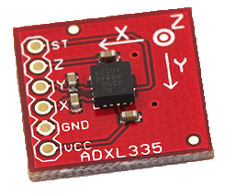
A/D Conversion
Compared measured values for moving and not moving in debugger
Method (for each axis)
  Average handful of samples
  on setup.
  For other samples, we
  average a handful
  If measured average reaches
  a threshold distance from first
  average, there is movement

Slide 2
A/D Conversion
Works in LPM3 Mode
Settings left at default
  Sampling/Conversion time, etc.
  Needs further testing to
  refine

Slide 3
Low Power
The next step:
  Refine the A/D conversion
    More testing
  Add external signal to wake processor up
  (from other boards in the stack)

